Slide 1
2024 REPORT
Global Fundraising Campaign Performance Report
Data Analysis Dashboard — A comprehensive review of campaign outcomes, platform effectiveness, donor engagement, and marketing ROI across global initiatives.

Slide 2
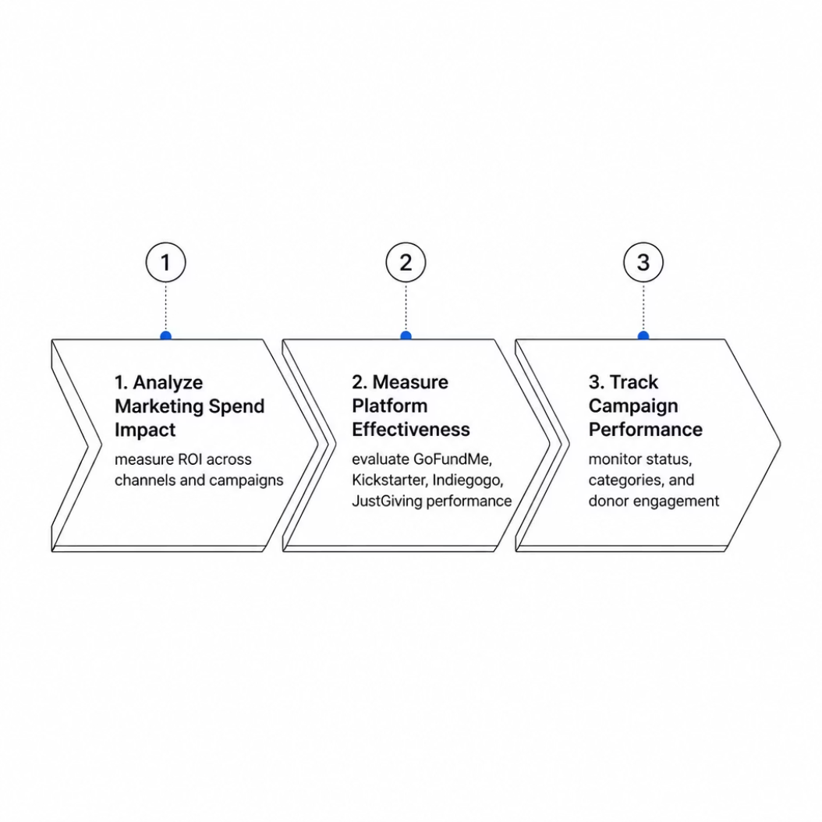
STRATEGIC FRAMEWORK
Objectives & Key Performance Indicators
What We Set Out to Measure
This report evaluates three core dimensions of global fundraising performance to guide future strategy and resource allocation.
$2.4B
$1.2B
Fundraising Goal
Amount Raised
Target across all categories
Total contributions received
50.06%
9.8M+
Achievement Rate
Total Donors
Goal vs. actual raised
Global contributor base

Slide 3
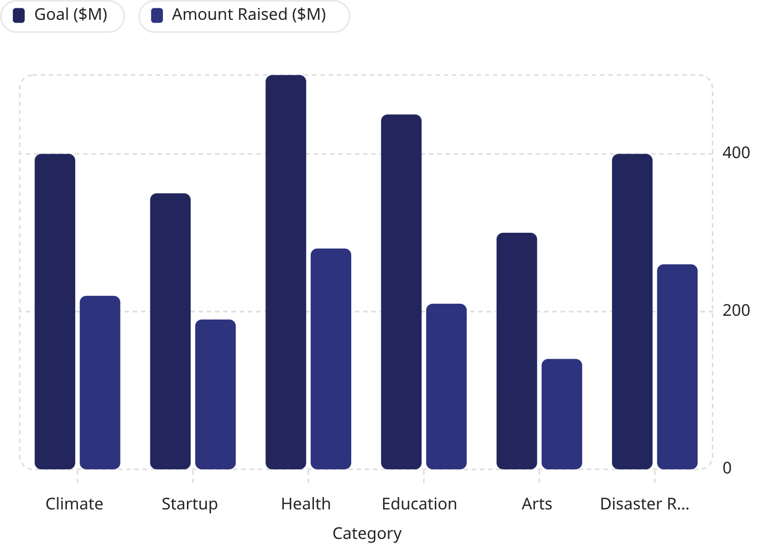

CATEGORY ANALYSIS
Goal vs. Amount Raised by Category
Key Observations
Health leads in absolute dollars raised at $280M, while Disaster Relief shows the strongest achievement rate at 65%. Arts underperforms relative to its goal, signaling a need for targeted outreach.
Disaster Relief and Health demonstrate the highest fundraising potential and donor responsiveness across all categories.

Slide 4
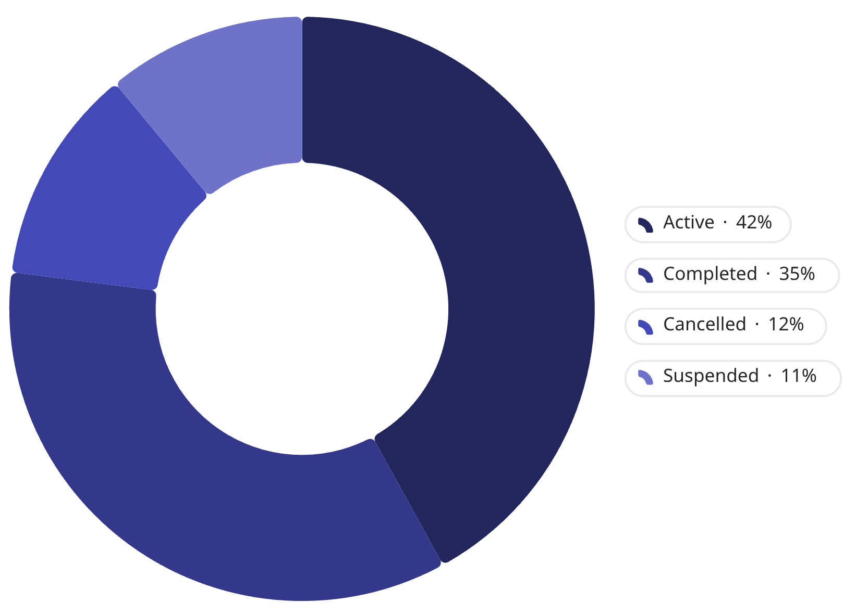
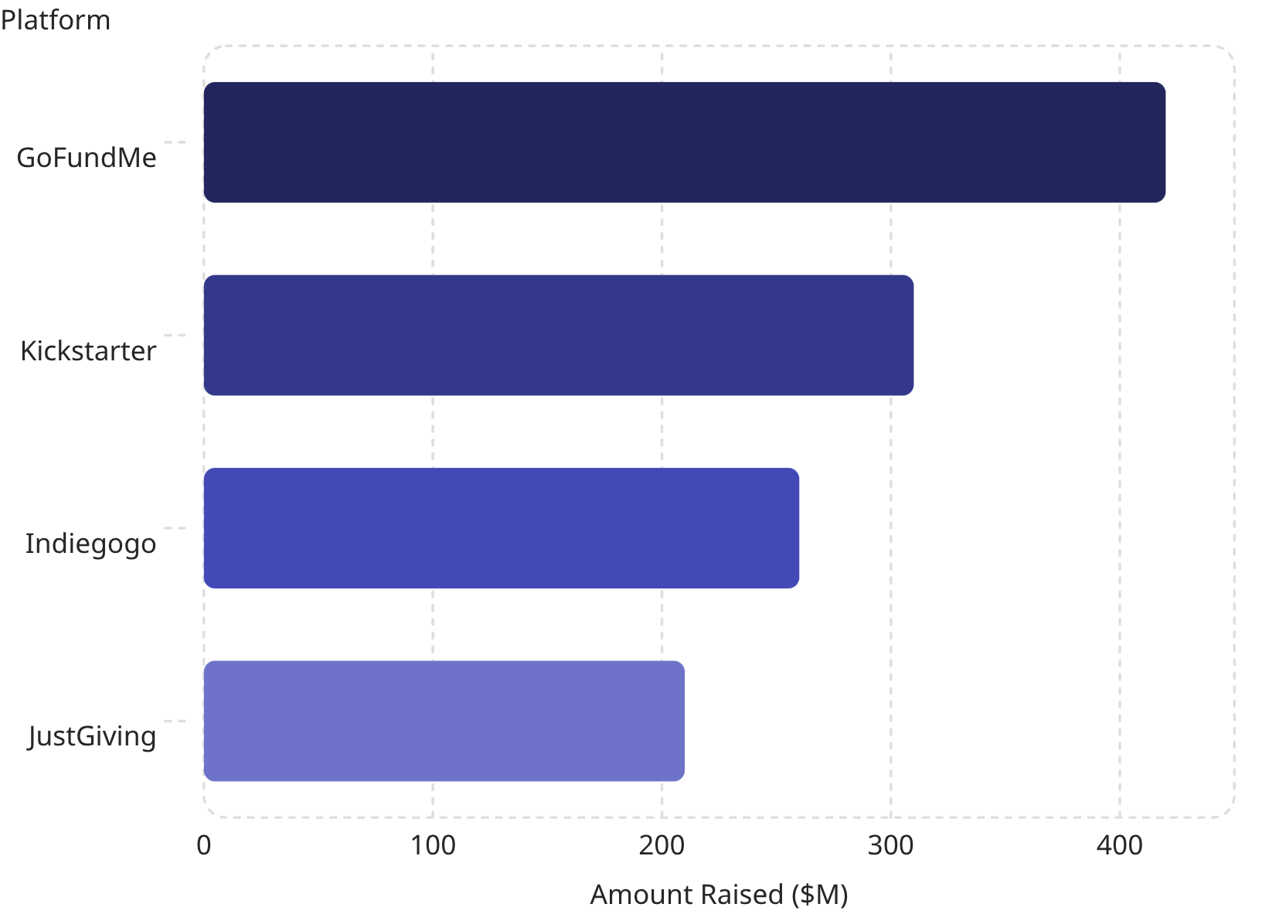
PLATFORM & STATUS
Campaign Performance Overview
Campaign Status Distribution
Platform Performance — Amount Raised ($M)
GoFundMe dominates with 35% of total raised. 77% of campaigns are Active or Completed — a healthy operational pipeline.

Slide 5
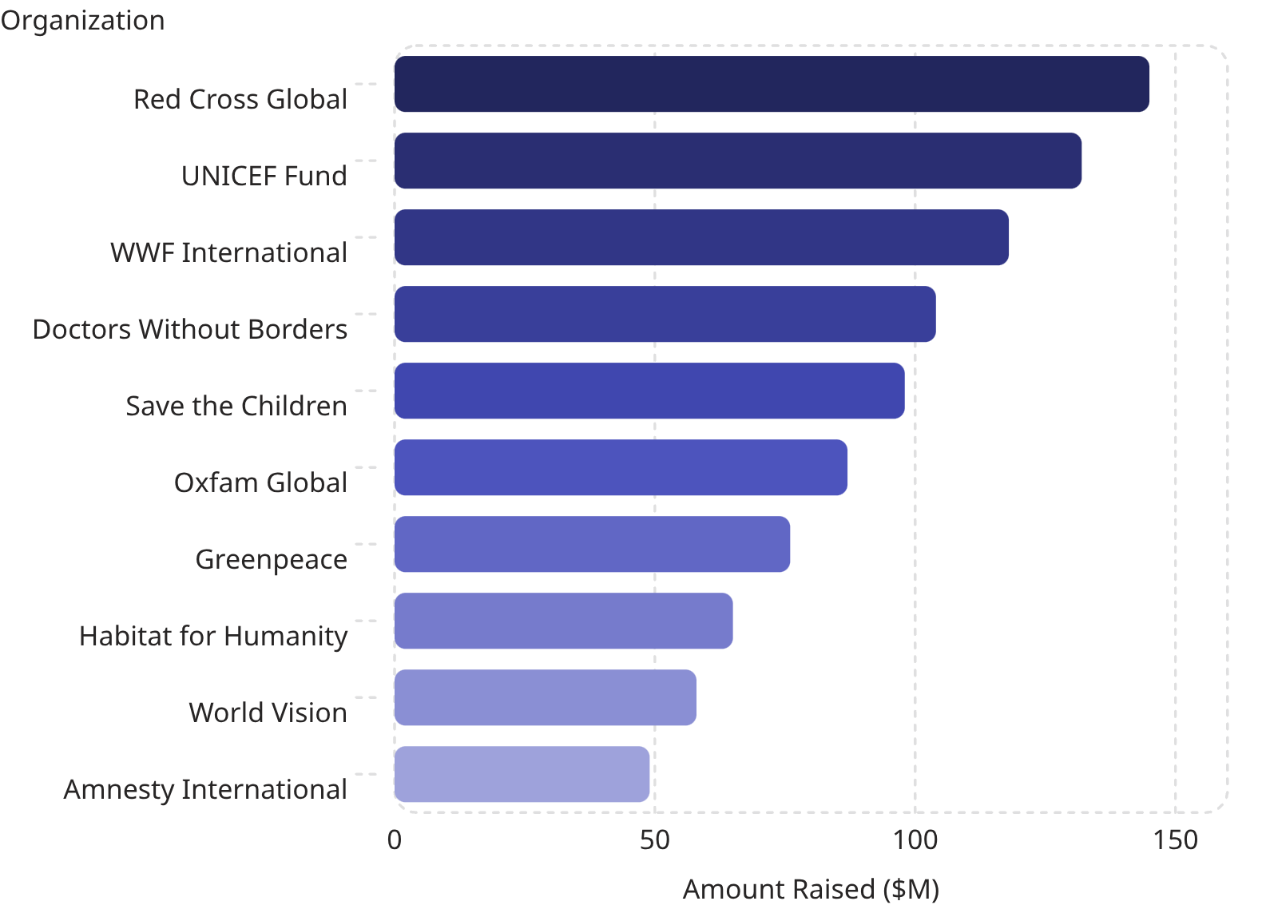
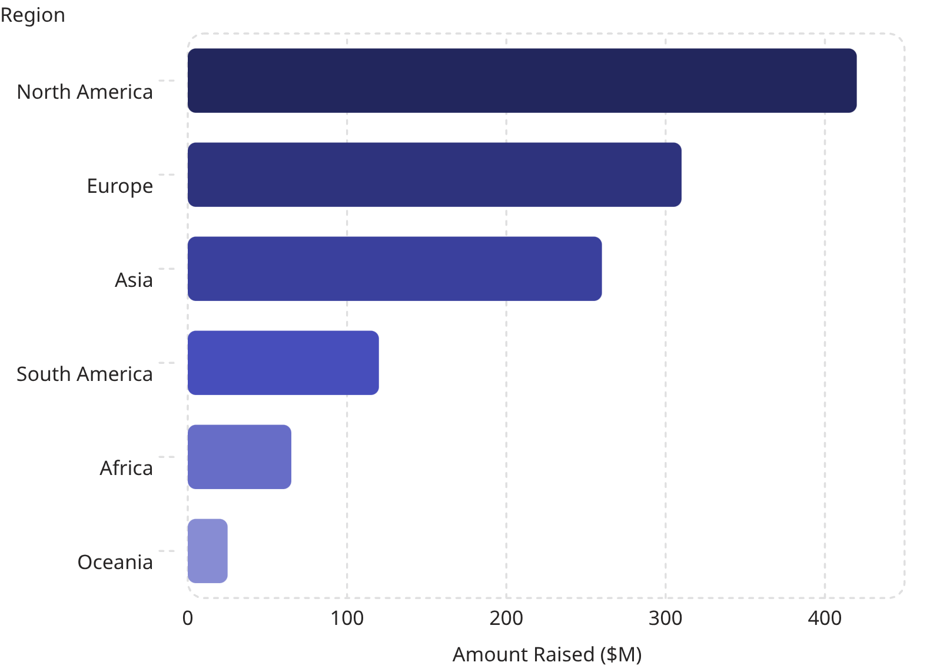
ORGANIZATION & GEOGRAPHY
Organization & Regional Fundraising Analysis
Top 10 Organizations by Amount Raised ($M)
Fundraising by Region ($M)
North America and Europe account for over 60% of total funds. Emerging markets in Asia and South America represent significant untapped potential.

Slide 6
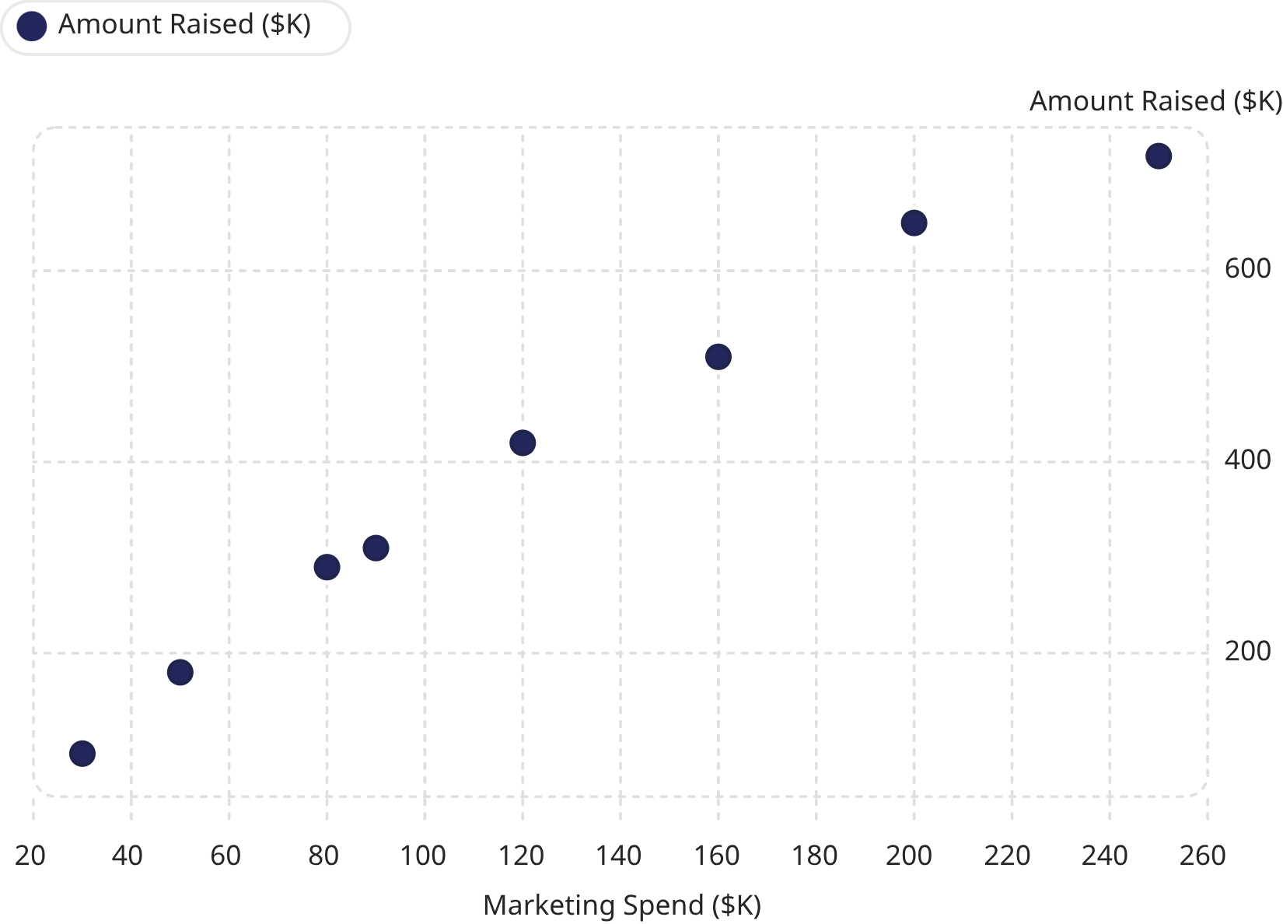

MARKETING ROI
Marketing Spend vs. Fundraising Success
Key Observations
Positive Correlation
Higher marketing investment consistently drives greater fundraising returns across campaigns.
Diminishing Returns
Beyond $200K spend, incremental gains moderate — optimize rather than overspend.
Strategic Allocation
Concentrating spend on Health and Disaster Relief yields the highest ROI.

Slide 7





CONCLUSION
Key Insights & Strategic Takeaways
50.06% Achievement Rate
9.8M+ Donors Engaged
Marketing Drives Results
Half the goal met — significant room to scale with refined targeting.
A massive global base — focus on retention and recurring giving.
Spend and fundraising outcomes are positively correlated — invest strategically.
Platform Performance Varies
High-Potential Categories
GoFundMe leads — align platform choice with campaign category and audience.
Disaster Relief and Health show the strongest donor response — prioritize these verticals.
Thank you for your attention. Together, we build a more impactful future.

